Slide 1

Golden Eagle Class
2026 - 2027
Year 6: Miss Nandhra
Class TA: Mr Merton

Slide 2
Transition so far…
As part of our whole school ‘Jigsaw’ programme, we have been discussing transition / moving on during lesson time.
Teachers are holding meetings to discuss children: academic and pastoral information has been shared.
Children will have the chance to visit their new class their teacher on Tuesday 8th July when they will complete a morning of activities. In addition, children will discuss their strengths and areas for development to share with their new teacher.
Some children have started informal visits to new classrooms / areas to become familiar with the space.
Social stories will be sent out to specific children for over the summer

Slide 3




Year 6 overview
Topics:
The USA
WW2
The Ancient Maya Civilisation
Residential
SATs
Buddies
Year 6 production

Slide 4
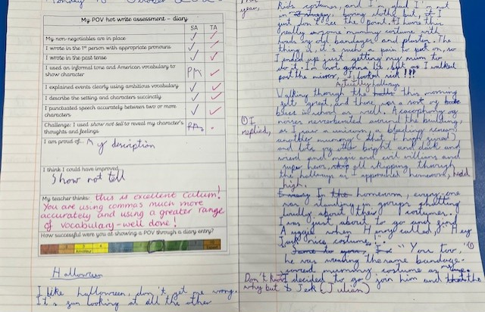
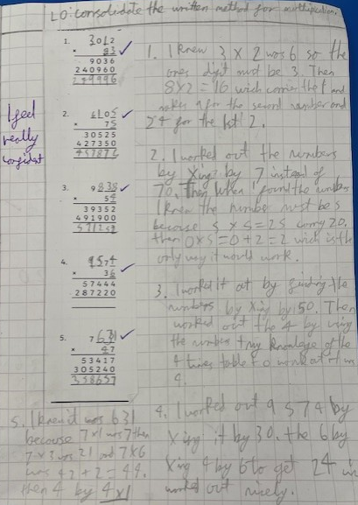
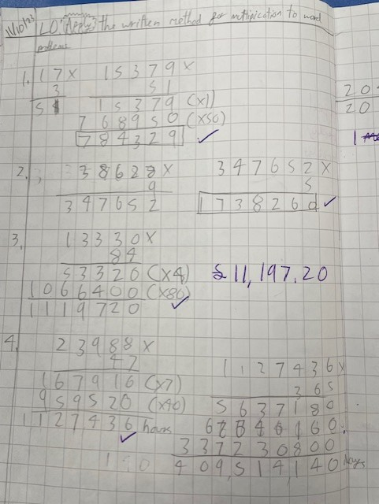
What are we aiming for?

Slide 5
Class / year group specifics
Swimming – Year 6 will go in Term 1 Tuesday 8th September 2026
Communication methods – class pages, newsletters each main term, class emails, admin email, end of the day, phone etc.
More information about PE days etc, will be communicated in your first class newsletter (please ensure your child is in the correct PE kit on these days). Earrings should be taped up. The start of the summer holidays is the best time to get your child’s ear pierced so they can be removed for PE lessons.
If wearing laces, can they do these independently
Any medication should be sent in at the start of term with care plans
Year 6 will continue learning ukuleles.
Walking home permission forms will be sent home in September. These must be returned for safeguarding reasons.
Mobile phones for Year 6 only if absolutely necessary and at your own risk – these will be collected in and stored during the school day. No watches with games on or that can be used like a phone!
MCAS. (My Child at School)
Homework – Daily reading, Atom learning (Maths and English) and spelling shed.
Do not send fiddle toys / pencil cases etc in

Slide 6
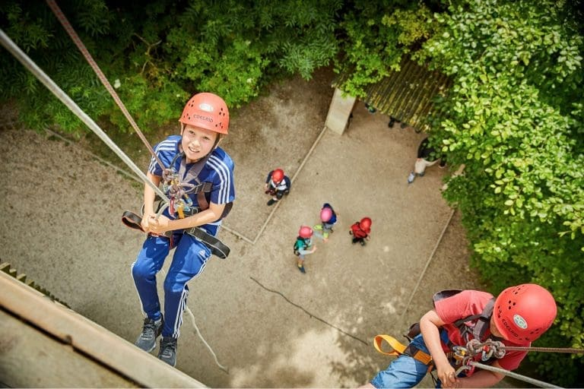
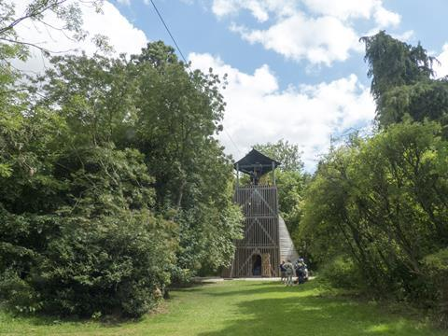
Year 6 Residential
PGL Green Park, Aston Clinton (near Aylesbury) from Wednesday 17th – Friday 19th March 2027.

Slide 7
Year 6 SATs 2027
Monday 10th May to Thursday 13th May 2027
Reading
Mathematics – Arithmetic (Paper 1) , Reasoning (Paper 2 and 3)
Spelling, grammar and punctuation

Slide 8
Ways to support your child over the Summer holiday…
Your child’s end of year report will be sent home before the end of term. This will outline next steps that your children need to take in Maths, English and Science. Please support your child in developing these skills over the holidays, so they can hit the ground running in September.
Children should continue reading regularly over the summer holidays – this has a HUGE impact!
Ensure your child has all the uniform and equipment they need for September.

Slide 9
Involving you next year…
Class email address: goldeneagles@watlington.oxon.sch.uk if you have any small issues or messages
We will keep the class pages updated on a regular basis.
Clubs are open to all – if your child hasn’t done a club before, we encourage them to give one a try! Support is available for paid clubs.
We will hold a parents’ evening in the autumn term.

Slide 10
Any questions?
Class email: : goldeneagles@watlington.oxon.sch.uk – we will try to respond to any further questions as soon as possible.
A copy of this presentation will be included on the current Golden Eagles class page.

