Slide 1

Bats Class
2026 - 2027
Year 1: Mrs eltham
Class TA’s: mrs heycock
Mrs Bromley

Slide 2
Transition so far…
As part of our whole school ‘Jigsaw’ programme, we have been discussing transition / moving on during lesson time.
Teachers are holding meetings to discuss children: academic and pastoral information has been shared.
Children will have the chance to visit their new class and their teacher on Wednesday 8th July when they will complete a morning of activities. In addition, children will discuss their strengths and areas for development to share with their new teacher.
Some children have started informal visits to new classrooms / areas to become familiar with the space.
Social stories will be sent out to specific children for over the summer

Slide 3
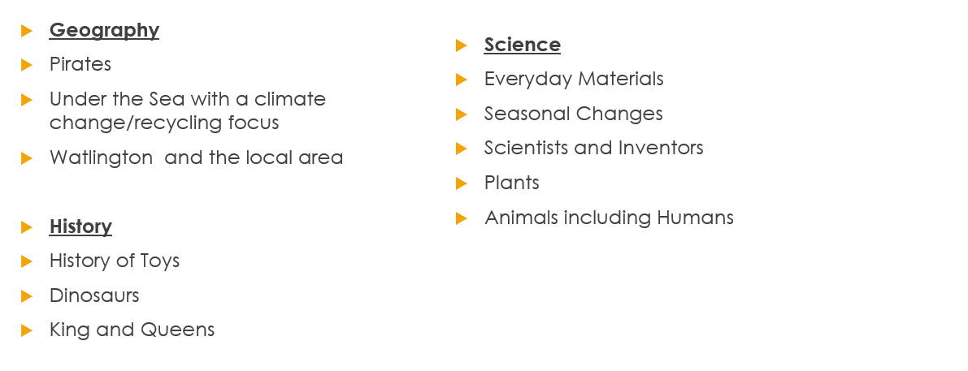
Year 1 overview – Topics for the year ahead

Slide 4
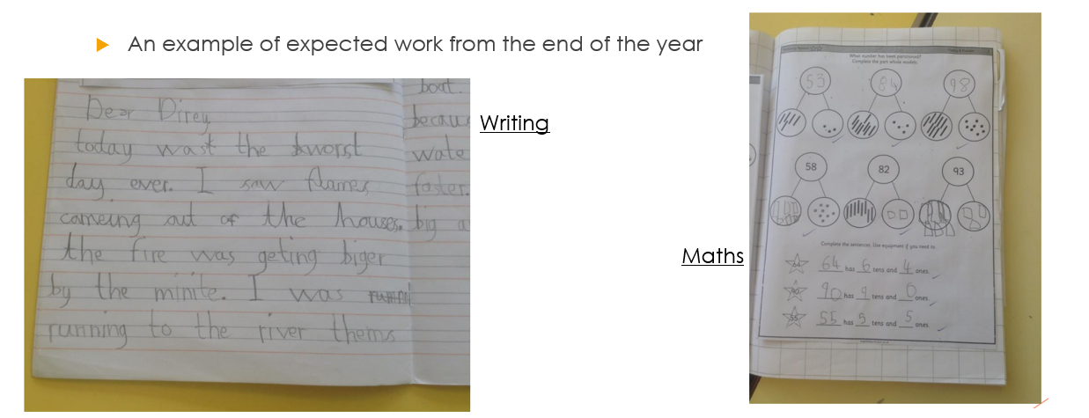
What are we aiming for?

Slide 5
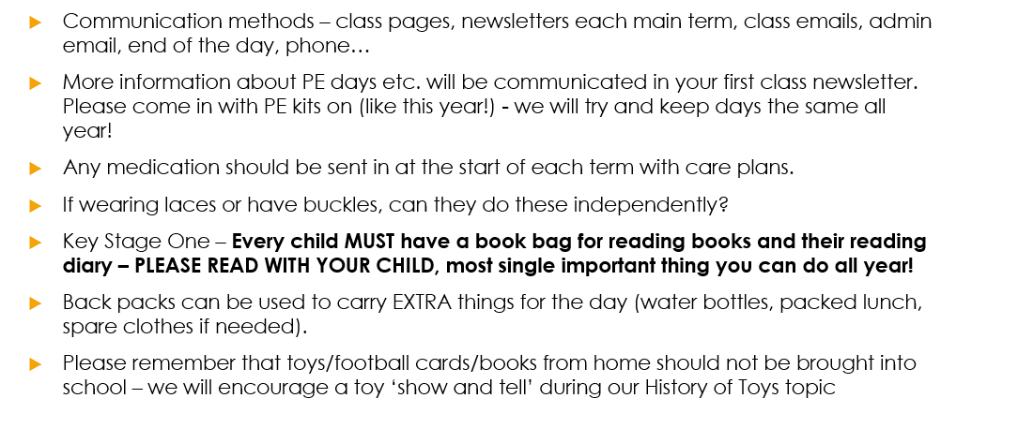
Year 1 Specifics

Slide 6
Continuous Provision in Year 1
Continuous provision is a structured approach to learning that encourages children to explore, make choices, and consolidate knowledge and skills.
The classroom is set up for independent exploration and organised into the different subject areas, which all contain resources and activities linked to the National Curriculum.
This approach promotes self-directed learning, and fosters resilience, confidence, and curiosity. By linking EYFS practices with KS1 curriculum expectations, continuous provision ensures consistency and provides opportunities for children to develop a wide range of skills in a supportive environment.
Research has shown that continuous provision enhances engagement and improves retention of concepts.

Slide 7
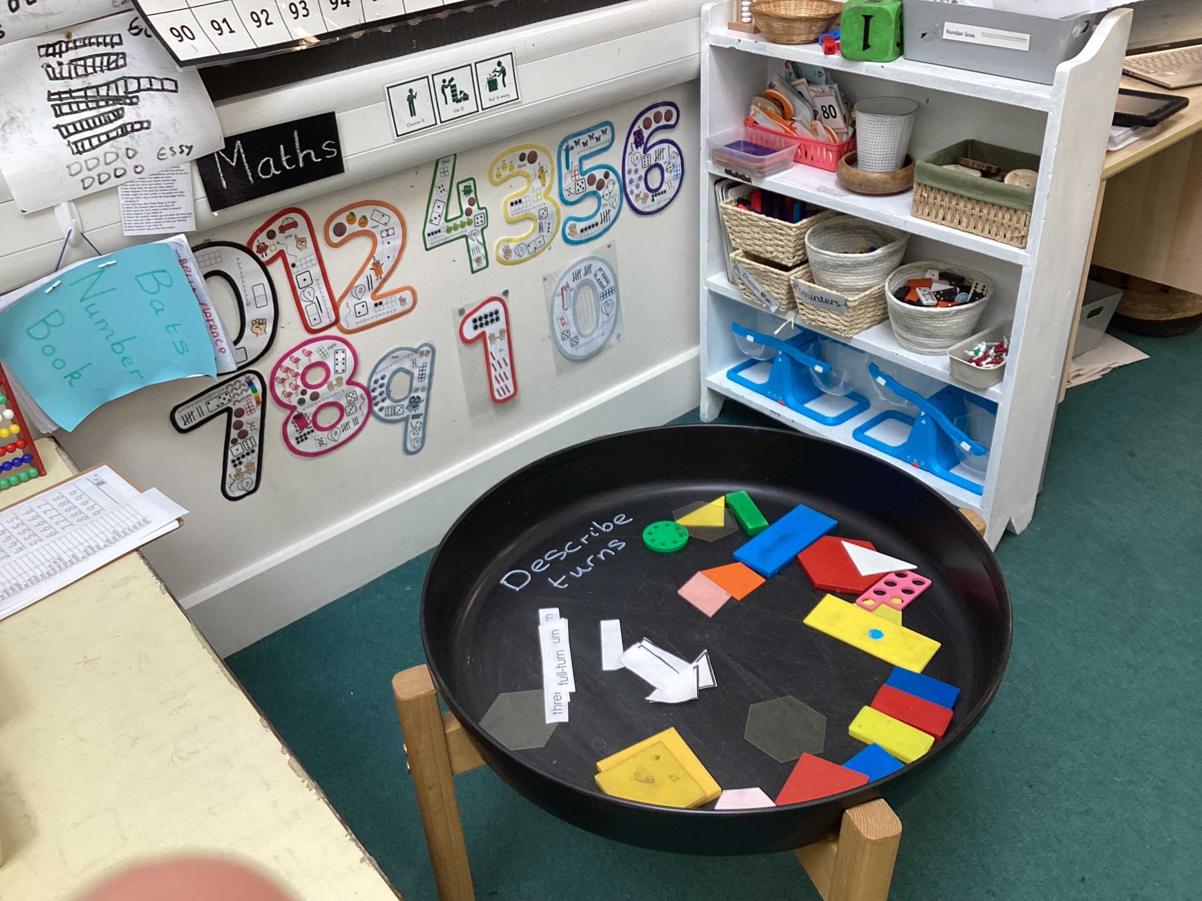
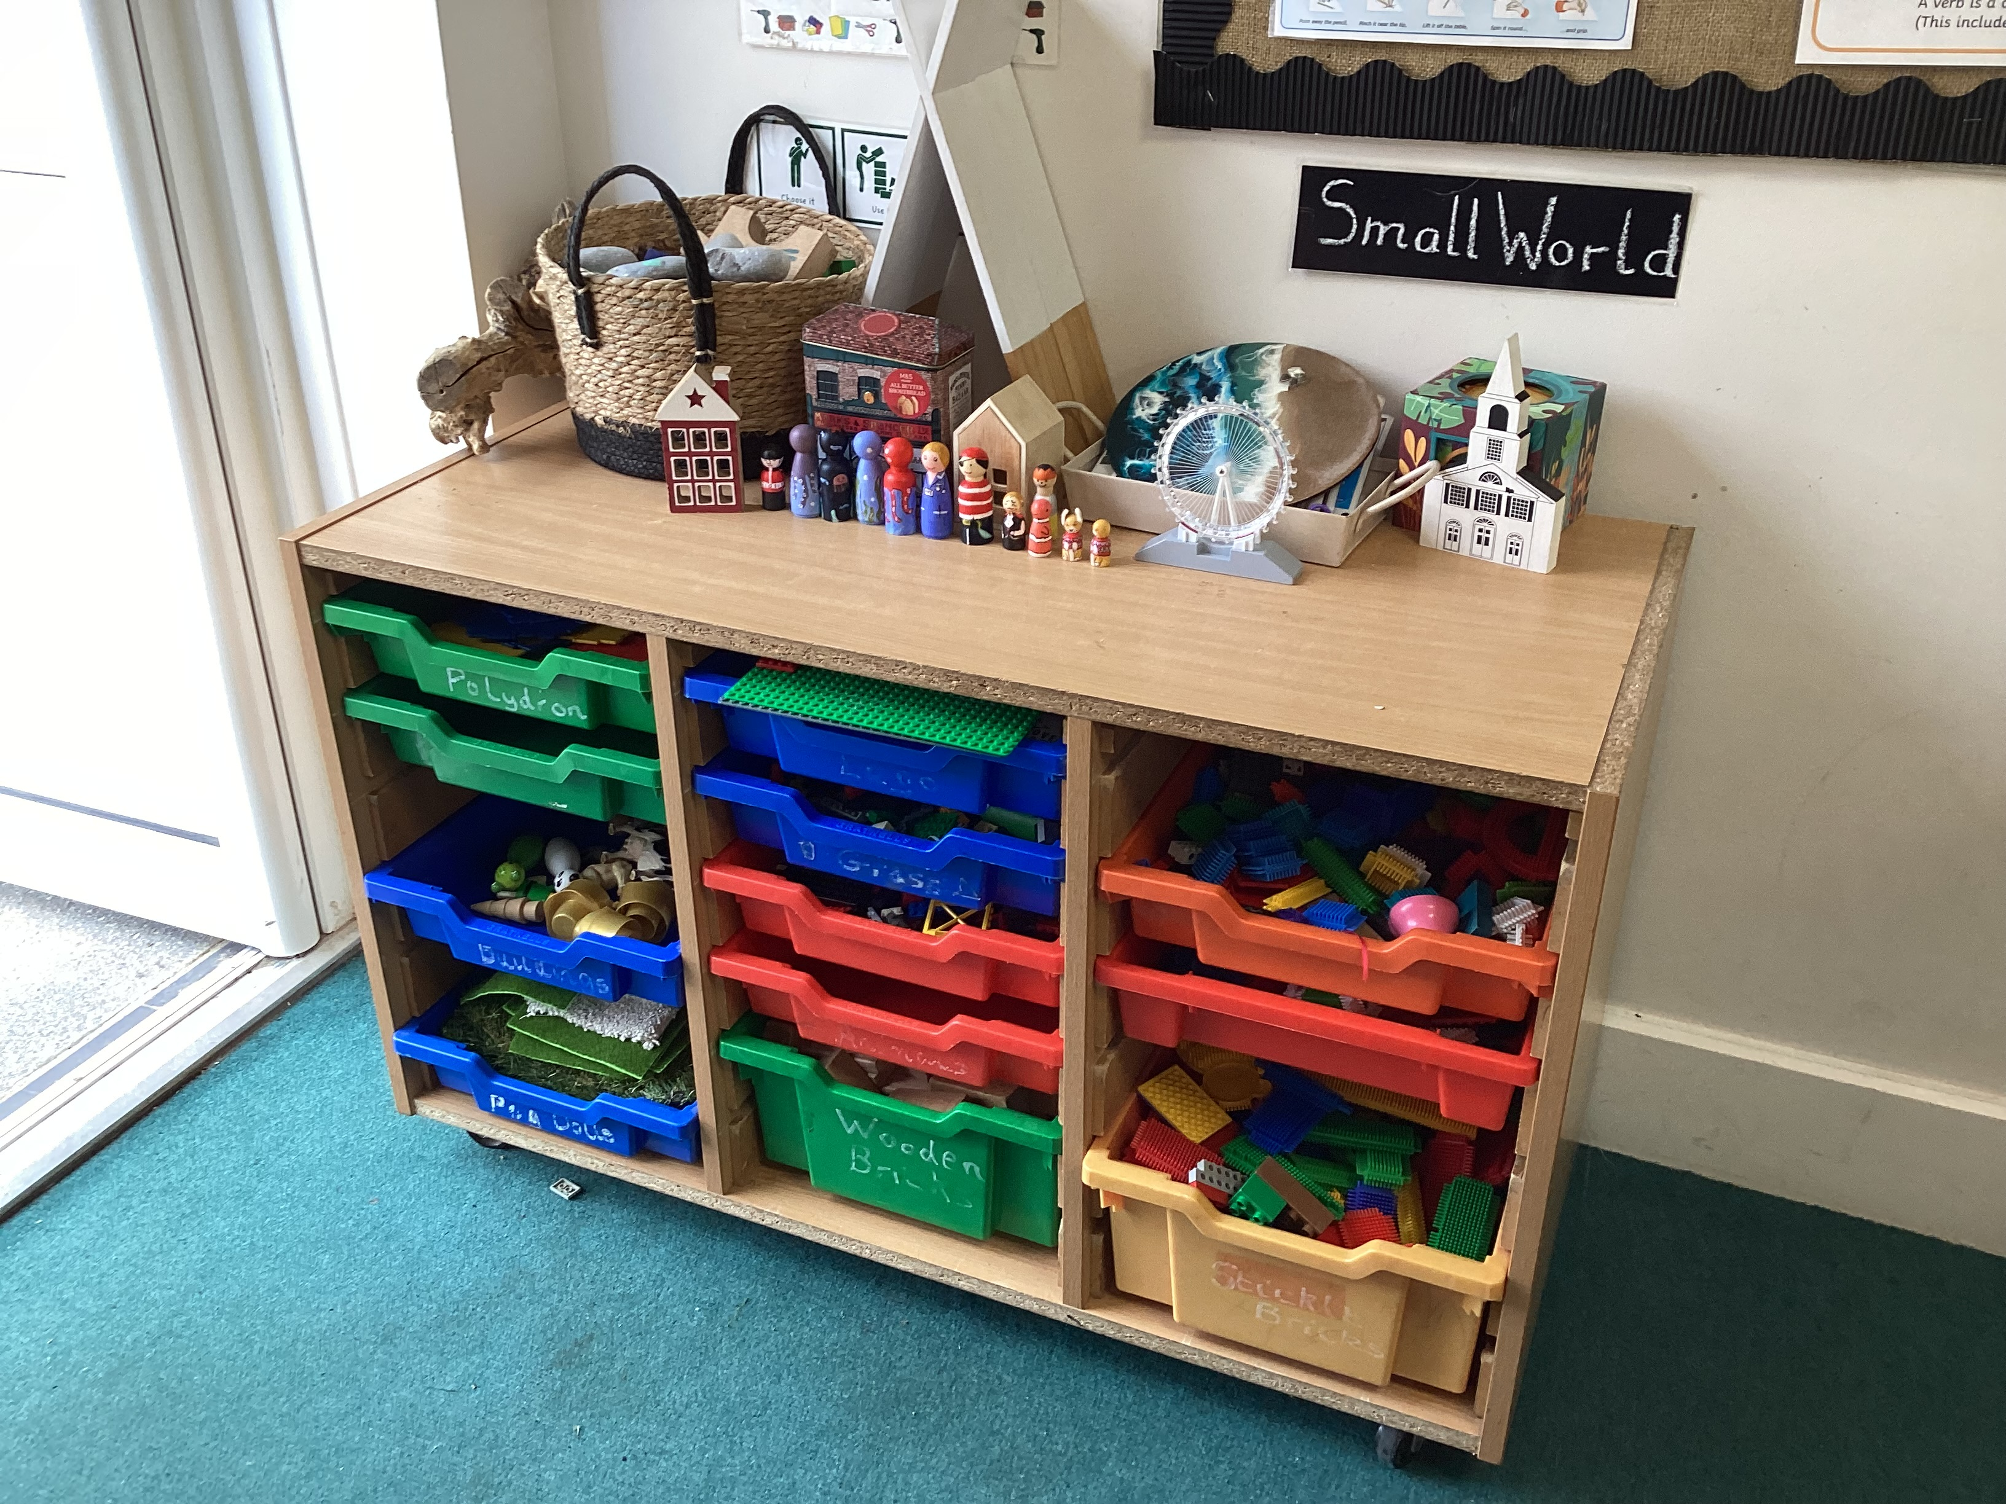
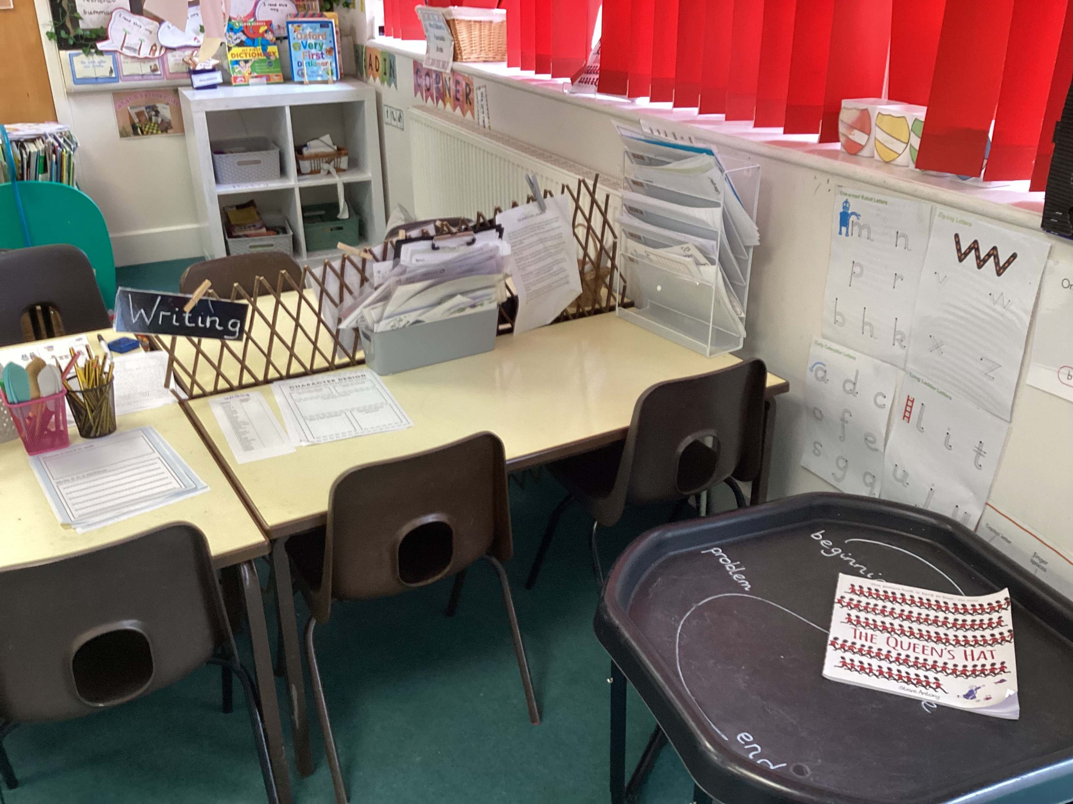
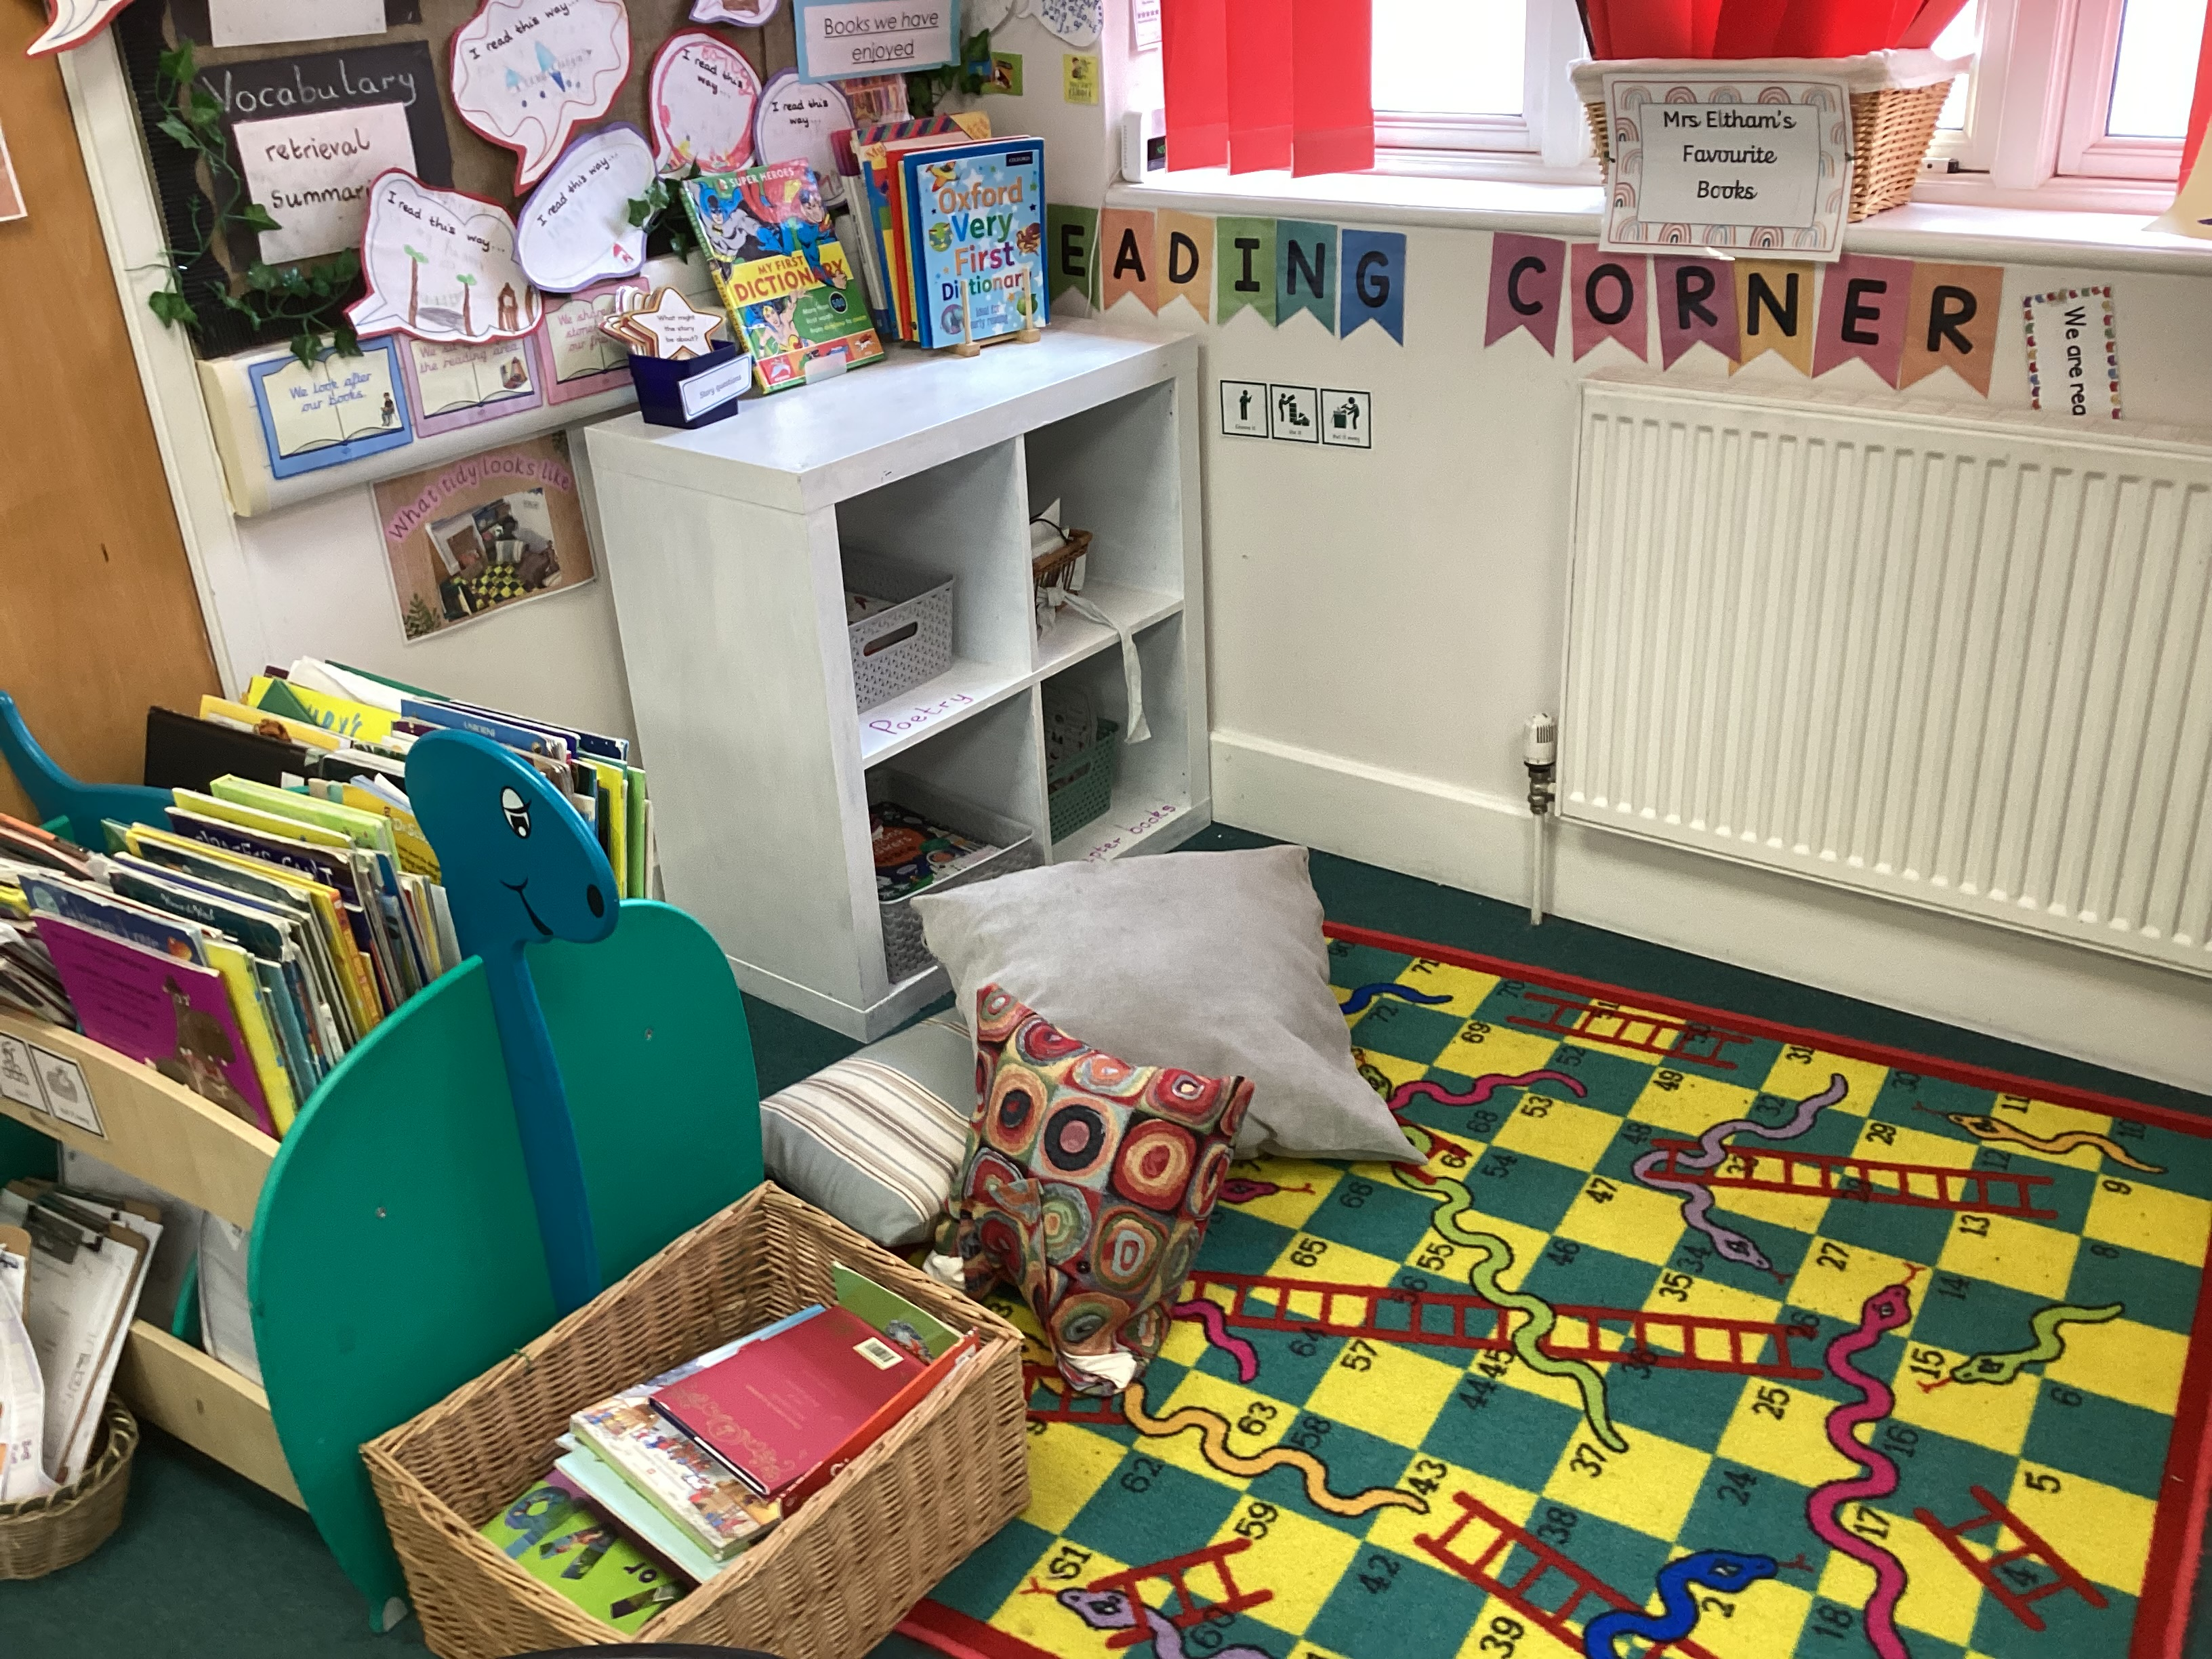
Continuous Provision in Year 1
Some areas of our classroom …

Slide 8
Phonics Screening in Year 1
What is the phonics screening check?
All year 1 pupils in England take the phonics screening check. It’s done in school by our staff.
The check is made up of 40 words, and usually lasts 5-10 minutes. Some words are real words, and others are nonsense, or ‘alien’ words, that help to show if pupils can work out how to decode words they haven’t seen before.
The check helps us to see: How pupils are progressing in phonics and where to provide additional teaching and support
When will it be happening?
Year 1 will do the phonics screening check in June 2027.
We will be sharing more information about the process of this check as the academic year progresses.
Children will have daily phonics lessons in preparation for this.
The children will continue to follow the ELS phonics programme that they follow in Reception.

Slide 9
Phonics, Spelling and Reading
Reading diaries: They are a vital recording system for all year 1s and support communication between teachers and parents about progress and next steps. You need to listen to your child read at least 3 times a week and record this in their diary.
Reading books: Your child will continue to have a phonics book each week linked to their level as well as a phonics book that is linked to the phonics sounds that we are teaching that week. They will also have an opportunity to visit the KS1 library regularly and bring home a sharing book (to enjoy with an adult!)
Phonics: ELS is our phonics programme that we follow in school. This will be continued at the start of year 1 and will be delivered throughout the year.

Slide 10
Ways to support your child over the Summer holiday…
Your child’s end of year report will be emailed before the end of term. This will outline next steps that your children need to take in Maths, English and Science. Please support your child in developing these skills over the holidays, so they can hit the ground running in September.
Children should continue reading regularly over the summer holidays – this has a HUGE impact!
Ensure your child has all the uniform and equipment they need for September.

Slide 11
Involving you next year…
Class email address: bats@watlington.oxon.sch.uk if you have any small issues or messages
We will keep the class pages updated on a regular basis.
Clubs are open to all – if your child hasn’t done a club before, we encourage them to give one a try! Support is available for paid clubs.
We will hold a parents’ evening in the autumn term.

Slide 12
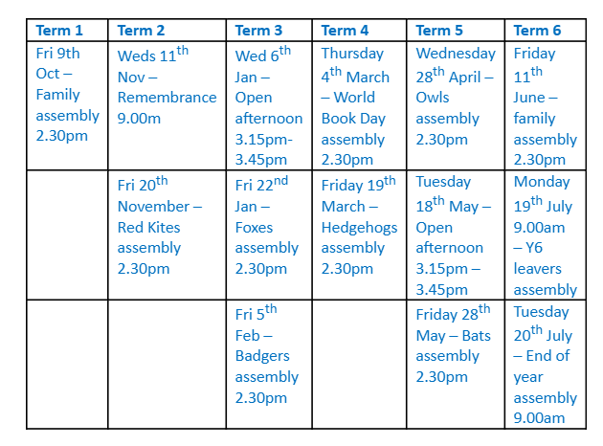
Open afternoon and assembly dates

Slide 13
Any questions?
Class email: : bats@watlington.oxon.sch.uk – we will try to respond to any further questions as soon as possible.
A copy of this presentation will be included on the current Bats class page.

