Slide 1

Red Kites Class
2026 - 2027
Year 5: Miss Geary
Class TA: Miss read

Slide 2
Transition so far…
As part of our whole school ‘Jigsaw’ programme, we have been discussing transition / moving on during lesson time.
Teachers are holding meetings to discuss children: academic and pastoral information has been shared.
Some children have started informal visits to new classrooms and areas to become familiar with the space.
Children have had the opportunity to visit their new class today, where they completed a range of activities.
Social stories will be sent out to specific children for over the summer.

Slide 3

Year 5 Overview
Term 1 topic: Anglo Saxons / Vikings. We will make cross-curricular links in our English and other subject lessons (e.g. art / DT).
English – How To Train Your Dragon (Overcoming a Monster story / Instruction writing / Kennings)
Maths – continue to build on areas of development identified as part of transition meetings, including multiplication facts.

Slide 4
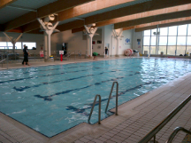
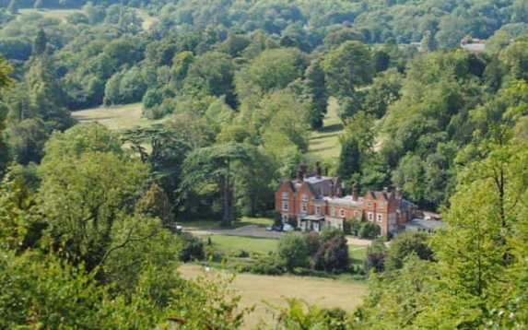
Year 5 Overview
Swimming will happen during term 2 (October-Christmas)
Bikeabilty has been booked – more information to follow.
The Year 5 residential has been booked for 5th – 7th May 2027. Juniper Hall in Surrey.

Slide 5
Class / year group specifics
Communication methods – class pages, newsletters each main term, class emails, MCAS, end of the day, phone.
More information about PE days etc., will be communicated in the class newsletter in September. Children will need to come to school in PE kits on these days– remember to send in spares if the weather is bad! Ear rings must be taped up. Summer is the best time to get your child’s ear pierced so they can be removed for PE lessons.
Any medication should be sent in at the start of term with care plans.
Walking home permission forms will be sent home in September for Year 5 children. These must be returned for safeguarding reasons. We will not allow children to walk home unless we have been informed by a parent.
Children should not bring mobile phones in to school.
School day continues to be: 8.45am to 3.15pm (red gate will open at 8.40am)
Please do not send fiddle toys in!

Slide 6
Ways to support your child over the Summer holiday…
Your child’s end of year report will be sent home before the end of term. This will outline next steps that your children need to take in reading, writing and maths. Please support your child in developing these skills over the holidays, so they can hit the ground running in September.
Children should continue reading regularly over the summer holidays – this has a HUGE impact!
Times tables practice (TTR)
Practical maths – money, time and measures.
Ensure your child has all the uniform and equipment they need for September.

Slide 7
Involving you next year…
Class email address: redkites@watlington.oxon.sch.uk if you have any small issues or messages
We will keep the class pages updated on a regular basis.
Open afternoons and assemblies will continue next year – dates will be shared early on via our newsletters.
We will hold a parents’ evening in the autumn term.
Clubs are open to all – if your child hasn’t done a club before, we encourage them to give one a try! Support is available for paid clubs.
If you have any expertise on any of the topics, let us know!

Slide 8
Any questions?
Class email: redkites@watlington.oxon.sch.uk – we will try to respond to any further questions as soon as possible.
A copy of this presentation will be included on the current BADGERS class page.

