Slide 1

Watlington Primary School
Phonics Workshop
Thursday 26th February 2026

Slide 2




Getting all children to
read well, quickly.

Slide 3



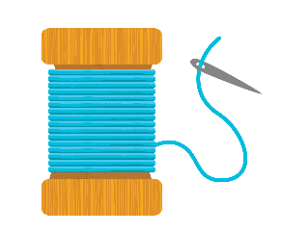
What is Phonics?
A method of teaching beginners to read and pronounce words by learning to associate letters or letter groups with the sounds they represent.
There are 44 main sounds in the English Language. Each sound is represented by a grapheme (the written representation of a sound).
Phoneme: the smallest single identifiable sound in a word.
For example, in the word 'cat' there are three phonemes c/a/t.
Grapheme: the written representation of a sound.
Digraph: two letters making one sound. For example, /sh/ in the word 'shop'.
Trigraph: three letters making one sound. For example, /igh/ in the word 'night'.
Split digraph: two vowel letters split but are split by one or more consonants. For example, /a-e/ in the word 'cake'.
© Oxford University Press 2021
Notes:
Begin by explaining what Phonics is. Explain that learning to read the English language is complex and that this information session will give parents & carers the understanding of what Phonics is, the terminolgy used in Phonics and how ELS gives children the skills and knowledge to read well, quickly.

Slide 4
How do we teach phonics?
Essential Letters and Sounds (ELS) is our chosen phonics programme
We use a simple, consistent approach to teaching phonics.
We have mnemonics and rhymes to support learning and recall
We teach phonics every single day from the first days of Reception
© Oxford University Press 2021
Notes:
Phonics teaches the link between the spoken sounds of our language and the written version of that sound – the code of our language.
As systematic synthetic phonics programme breaks this down into tiny steps for children to piece together which allows them to decode to read and then spell using the sound to spelling correspondences they have learnt.
We use a simple, consistent approach to teaching phonics.
Your child will experience the same classroom routines within each lesson which reduces cognitive load and maximises the chances of success.
All children are supported within the lesson to use their new phonic knowledge independently.
In every single ELS lesson, your child will make the direct application to reading.

Slide 5

How do we teach phonics? What it looks like?
© Oxford University Press 2021
Notes:
In ELS we do not ask children questions before we have taught them.
For example, when teaching a new sound, rather than asking children if they know any words with the sound in - we give the children 3 words that contain that sound. You can try this with your children at home.

Slide 6

How do we teach phonics?
© Oxford University Press 2021
Notes:
In the beginning of Reception, we learn to read words and then captions, phrases and sentences. As children learn more of the code of our language we are able to build more complex sentences for them to read.
Here we have a sentence from Year One. We build the code for the children and as this knowledge grows we are able to read more complex sentences.

Slide 7
Supporting your child with reading at home
Reading a bedtime story every night to your child improves their outcomes
Children are only reading from books that are entirely decodable
Your child should be able to read their book confidently
We only use pure sounds when decoding words (no ‘uh’ after the sound)
We want them to practise reading their book 4 times across the week working on these skills:
decode
fluency
expression
© Oxford University Press 2021
Notes:
We want children to only have success when learning to read
Decode – explain this meaning
Fluency – recognising the sound for spelling within the word and blending fluently
expression – model this for the children in school, when reading at home we want children to start to think about expression and intonation. For example, if someone is asking a question let’s get the children to make their voices sound like they are asking a question.

Slide 8
Pronouncing pure sounds
We must use pure sounds when we are pronouncing the sounds and supporting children in reading words.
c a t not cuh a tuh
If we mispronounce these sounds we will make reading harder for our children.
© Oxford University Press 2021
Notes:
If we use the ‘uh’ sound after the pure sound we are teaching the schwa.
For example instead of /c/ /a/ /t/ we teach /cuh/ /a/ /tuh/ - cuhatuh – not a word! IT makes blending harder if you teach or use a schwa after the initial sound.

Slide 9
Using sound buttons
We use sound buttons to help children recognise the different parts of a word. (single phonemes, digraphs, trigraphs and split digraphs)

Slide 10


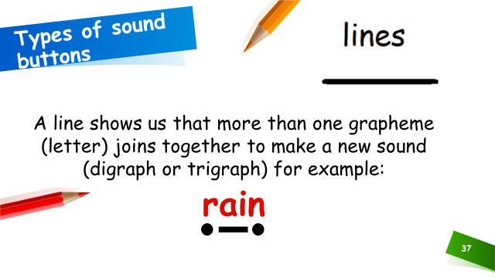
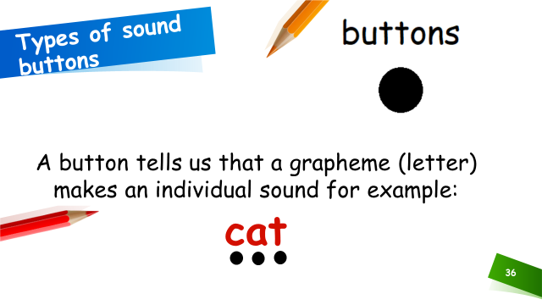
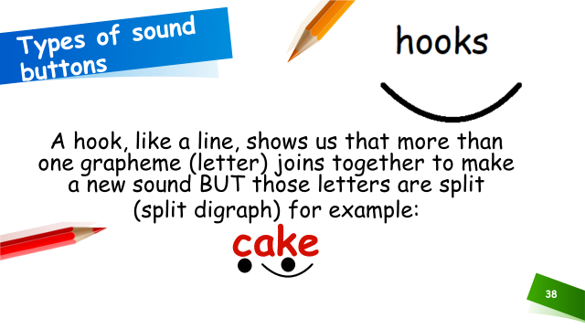
Using sound buttons

Slide 11
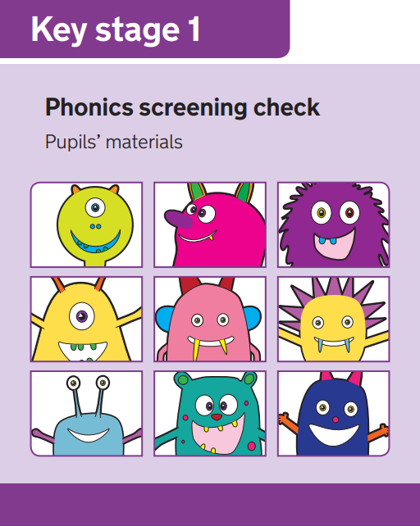
What is the aim of the check?
Phonics Screening in Year 1
The Phonics Screening Check is designed to confirm whether individual children have learnt phonic decoding (i.e. apply their knowledge of letter-sound relationships) and blending (i.e. the skill of joining individual speech sounds (phonemes) together to make a word) skills to an appropriate standard
This ‘mid-point’ check will allow teachers to ensure that any gaps in children’s knowledge is filled by the end of Year 2.

Slide 12
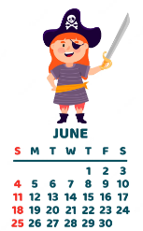
When will the screening happen?
All year 1 children will take the phonics screening during the week commencing Monday 8th June 2026.
All Year 2 children who did not pass the test in the previous year will also take the test during this window.

Slide 13
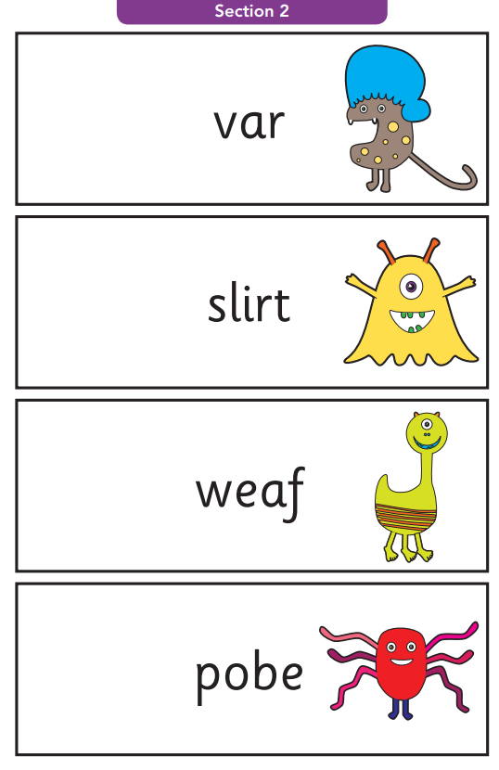
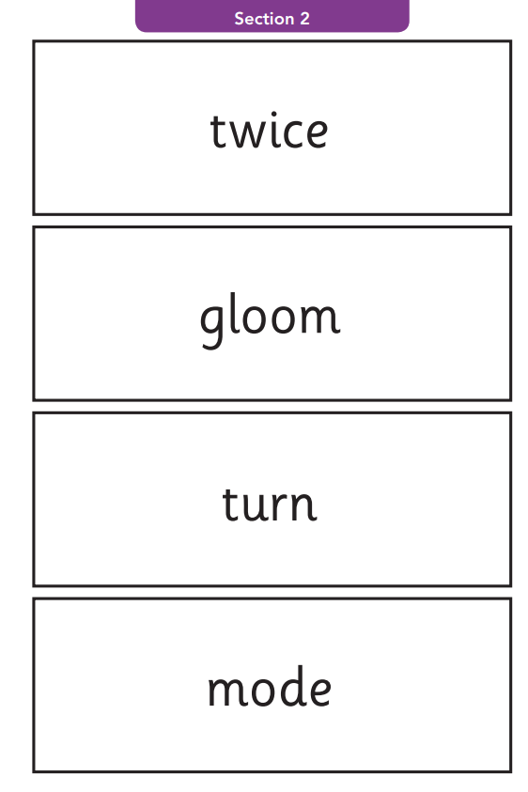
Example words
Alien/Pseudo words
Real words
‘Alien’ words are introduced to children from Reception

Slide 14
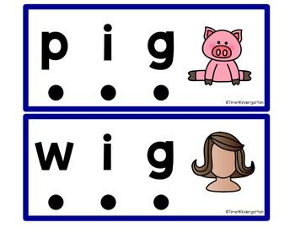
What do we expect children to do?
The check is very similar to tasks the children already complete during phonics lessons
Children will be asked to ‘sound out’ a word and blend the sounds together, eg d-o-g - dog
The focus of the check is to see which sounds the children know
THIS IS NOT A READING TEST

Slide 15

How will the children complete the check?
The children will complete the check one at a time in a quiet area of the school.
Layout will be very familiar.
The screening will only take 5-10 mins with each child.
With a familiar adult.
Low key approach to relax children

Slide 16
Useful websites
Here are some links to helpful website that give more information on the teaching of Phonics:
  Oxford Owl
https://home.oxfordowl.co.uk/reading/learn-to-read-phonics/
  Phonics Play:
https://www.phonicsplay.co.uk/InteractiveResources.htm
  YouTube – phoneme pronunciation:
https://www.youtube.com/watch?time_continue=18&v=UCI2mu7URBc&feature=emb_logo

Slide 17

Questions
© Oxford University Press 2021

