Slide 1

Owls Class
2025 - 2026
Year 2: Mrs Flynn (Monday-Thursday)
Miss Johnson (Friday)
Class TA: Miss Older

Slide 2
Transition so far…
As part of our whole school ‘Jigsaw’ programme, we have been discussing transition / moving on during lesson time.
Teachers are holding meetings to discuss children: academic and pastoral information has been shared.
Children will have the chance to visit their new class their teacher on Tuesday 8th July when they will complete a morning of activities. In addition, children will discuss their strengths and areas for development to share with their new teacher.
Some children have started informal visits to new classrooms / areas to become familiar with the space.
Social stories will be sent out to specific children for over the summer

Slide 3
Year 2 overview
History and Geography Topics for the year ahead:
The Great Fire of London and Significant people from the past (Terms 1-2)
Explorers (Terms 3-4)
Climate Change with a recycling focus (Term 5 and 6)
Science Topics
Everyday Materials
Living Things and their Habitats
Plants
Animals and Humans

Slide 4
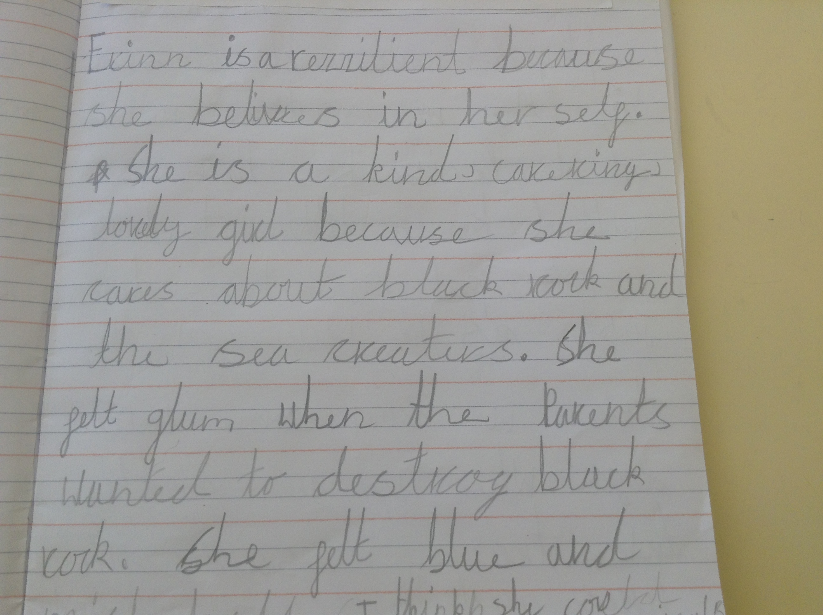
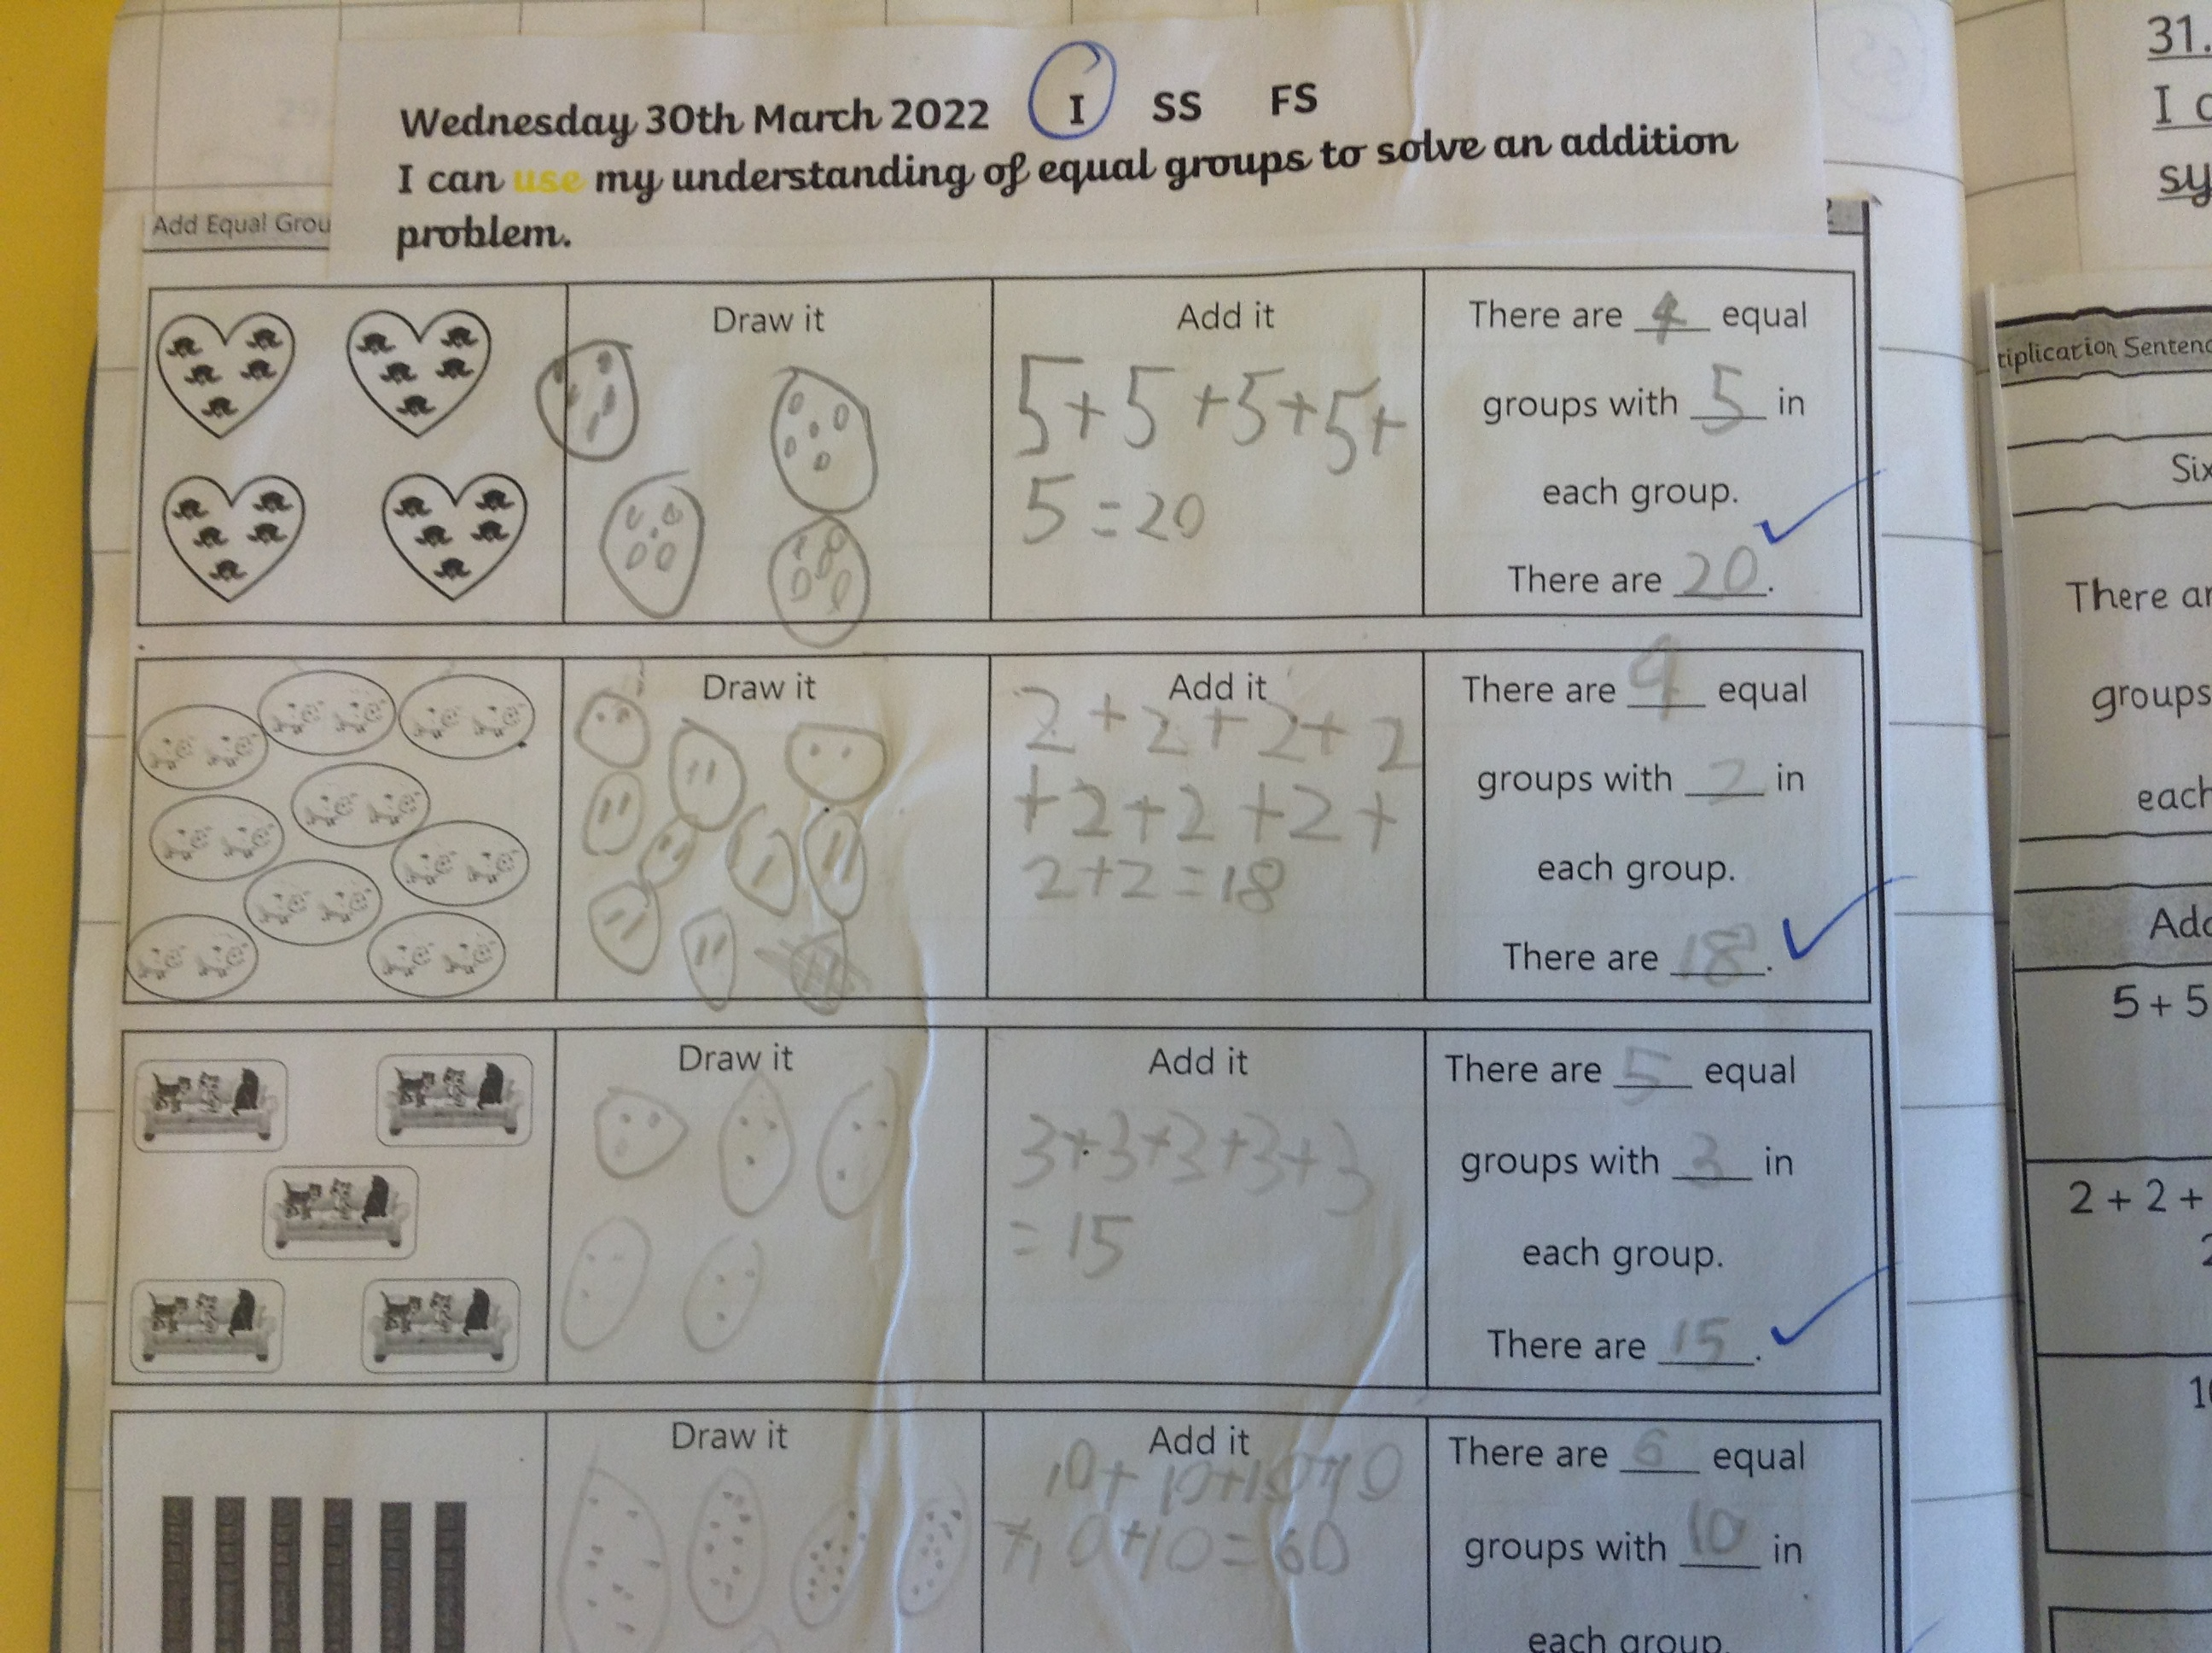
What are we aiming for?

Slide 5
Class / year group specifics
Communication methods – class pages, newsletters each main term, class emails, admin email, end of the day, phone…
More information about PE days etc, will be communicated in your first class newsletter: Come in with PE kits on (please ensure your child is in the correct PE kit on these days) -we will try and keep days the same all year! Ear rings should be taped up. Summer is the best time to get your child’s ear pierced so they can be removed for PE lessons.
If wearing laces, can they do these independently.
Any medication should be sent in at the start of term with care plans
Back packs can be used to carry EXTRA things for the day (water bottles, packed lunch, spare clothes if needed).
Key Stage One – Every child MUST have a book bag for reading books as this is stored by the classroom.

Slide 6
Ways to support your child over the Summer holiday…
Your child’s end of year report will be sent home before the end of term. This will outline next steps that your children need to take in Maths, English and Science. Please support your child in developing these skills over the holidays, so they can hit the ground running in September.
Children should continue reading regularly over the summer holidays – this has a HUGE impact!
Ensure your child has all the uniform and equipment they need for September.

Slide 7
Reading and Phonics
Reading diaries: They are a vital recording system for all year 2s and support communication between teachers and parents about progress and next steps. You need to listen to your child read at least 3 times a week and record this in their diary.
Reading books: Your child will continue to have a reading book each week linked to their level. They will also have an opportunity to visit the library each week and bring home a sharing book (to enjoy with an adult).
Phonics: ELS is our phonics and spelling programme that we follow in school. This will be continued through year 2

Slide 8
Spelling
Year 1 and 2 Common Exception words
Weekly Rules for the Year 2 Curriculum
Spelling Shed (logins to go home for home learning)

Slide 9
Practicalities
Water in bottles only – oral health focus
Lunches pre-ordered or a healthy lunch
No laces or buckles unless your child can do them up themselves!
Book bag in school every day
Any medication should be sent in at the start of term with care plans

Slide 10
Involving you next year…
Class email address: owls@watlington.oxon.sch.uk if you have any small issues or messages
We will keep the class pages updated on a regular basis.
Clubs are open to all – if your child hasn’t done a club before, we encourage them to give one a try! Support is available for paid clubs.
We will hold a parents’ evening in the autumn term.

Slide 11
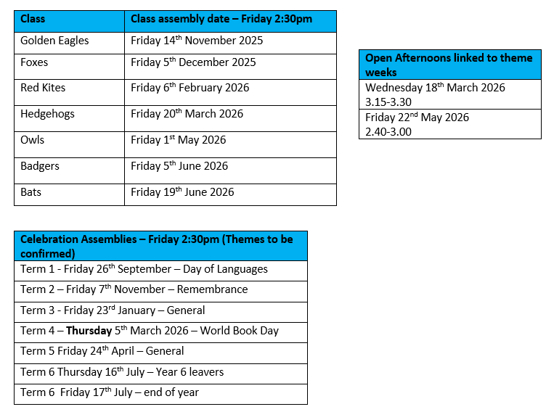
Open afternoon and assembly dates

Slide 12
Any questions?
Class email: : owls@watlington.oxon.sch.uk – we will try to respond to any further questions as soon as possible.
A copy of this presentation will be included on the current Owls class page.

