Slide 1

Bats Class
2025 - 2026
Year 1: Mrs ELTHAM and
MISS SHARMAN (Tuesday)
Class TA: Mrs heycock

Slide 2
Transition so far…
As part of our whole school ‘Jigsaw’ programme, we have been discussing transition / moving on during lesson time.
Teachers are holding meetings to discuss children: academic and pastoral information has been shared.
Children will have the chance to visit their new class their teacher on Tuesday 8th July when they will complete a morning of activities. In addition, children will discuss their strengths and areas for development to share with their new teacher.
Some children have started informal visits to new classrooms / areas to become familiar with the space.
Social stories will be sent out to specific children for over the summer

Slide 3
Year 1 overview – Topics for the year ahead
Geography
Pirates
Under the Sea with a climate change/recycling focus
Watlington and the local area
History
History of Toys
Dinosaurs
King and Queens
Science
Everyday Materials
Seasonal Changes
Scientists and Inventors
Plants
Animals including Humans

Slide 4
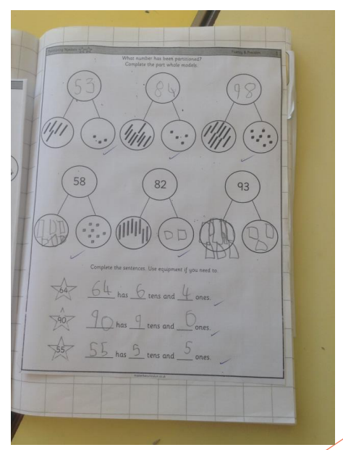
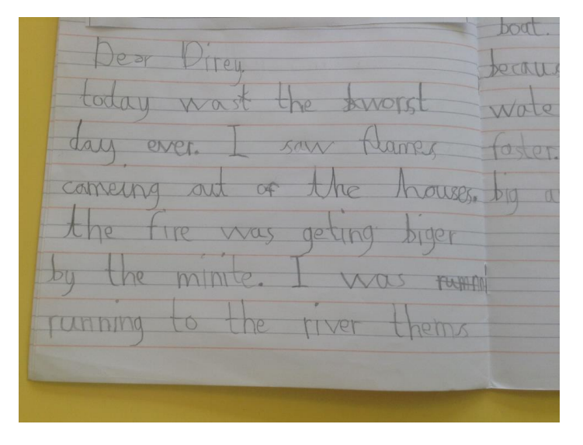
What are we aiming for?
An example of expected work from the end of the year
Writing
Maths

Slide 5
Year 1 Specifics
Communication methods – class pages, newsletters each main term, class emails, admin email, end of the day, phone…
More information about PE days etc. will be communicated in your first class newsletter. Please come in with PE kits on (like this year!) - we will try and keep days the same all year!
Any medication should be sent in at the start of each term with care plans.
If wearing laces or have buckles, can they do these independently?
Key Stage One – Every child MUST have a book bag for reading books and their reading diary – PLEASE READ WITH YOUR CHILD, most single important thing you can do all year!
Back packs can be used to carry EXTRA things for the day (water bottles, packed lunch, spare clothes if needed).
Please remember that toys/football cards/books from home should not be brought into school – we will encourage a toy ‘show and tell’ during our History of Toys topic on a rota system

Slide 6
Phonics Screening in Year 1
What is the phonics screening check?
All year 1 pupils in England take the phonics screening check. It’s done in school by our staff.
The check is made up of 40 words, and usually lasts 5-10 minutes. Some words are real words, and others are nonsense, or ‘alien’ words, that help to show if pupils can work out how to decode words they haven’t seen before.
The check helps us to see: How pupils are progressing in phonics and where to provide additional teaching and support
When will it be happening?
Year 1 will do the phonics screening check in June 2026.
We will be sharing more information about the process of this check as the academic year progresses.
Children will have daily phonics lessons in preparation for this.
The children will continue to follow the ELS phonics programme that they follow in Reception.

Slide 7
Phonics, Spelling and Reading
Reading diaries: They are a vital recording system for all year 1s and support communication between teachers and parents about progress and next steps. You need to listen to your child read at least 3 times a week and record this in their diary.
Reading books: Your child will continue to have a phonics book each week linked to their level as well as a phonics book that is linked to the phonics sounds that we are teaching that week. They will also have an opportunity to visit the KS1 library regularly and bring home a sharing book (to enjoy with an adult!)
Phonics: ELS is our phonics programme that we follow in school. This will be continued at the start of year 1 and will be delivered throughout the year.

Slide 8
Ways to support your child over the Summer holiday…
Your child’s end of year report will be sent home before the end of term. This will outline next steps that your children need to take in Maths, English and Science. Please support your child in developing these skills over the holidays, so they can hit the ground running in September.
Children should continue reading regularly over the summer holidays – this has a HUGE impact!
Ensure your child has all the uniform and equipment they need for September.

Slide 9
Involving you next year…
Class email address: bats@watlington.oxon.sch.uk if you have any small issues or messages
We will keep the class pages updated on a regular basis.
Clubs are open to all – if your child hasn’t done a club before, we encourage them to give one a try! Support is available for paid clubs.
We will hold a parents’ evening in the autumn term.

Slide 10
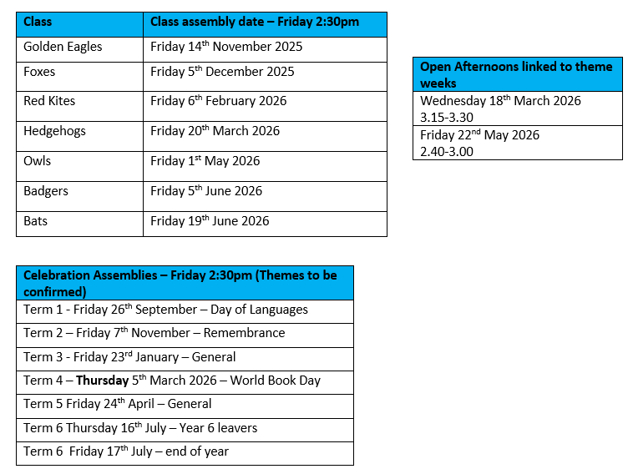
Open afternoon and assembly dates

Slide 11
Any questions?
Class email: : bats@watlington.oxon.sch.uk – we will try to respond to any further questions as soon as possible.
A copy of this presentation will be included on the current Bats class page.

