Slide 1
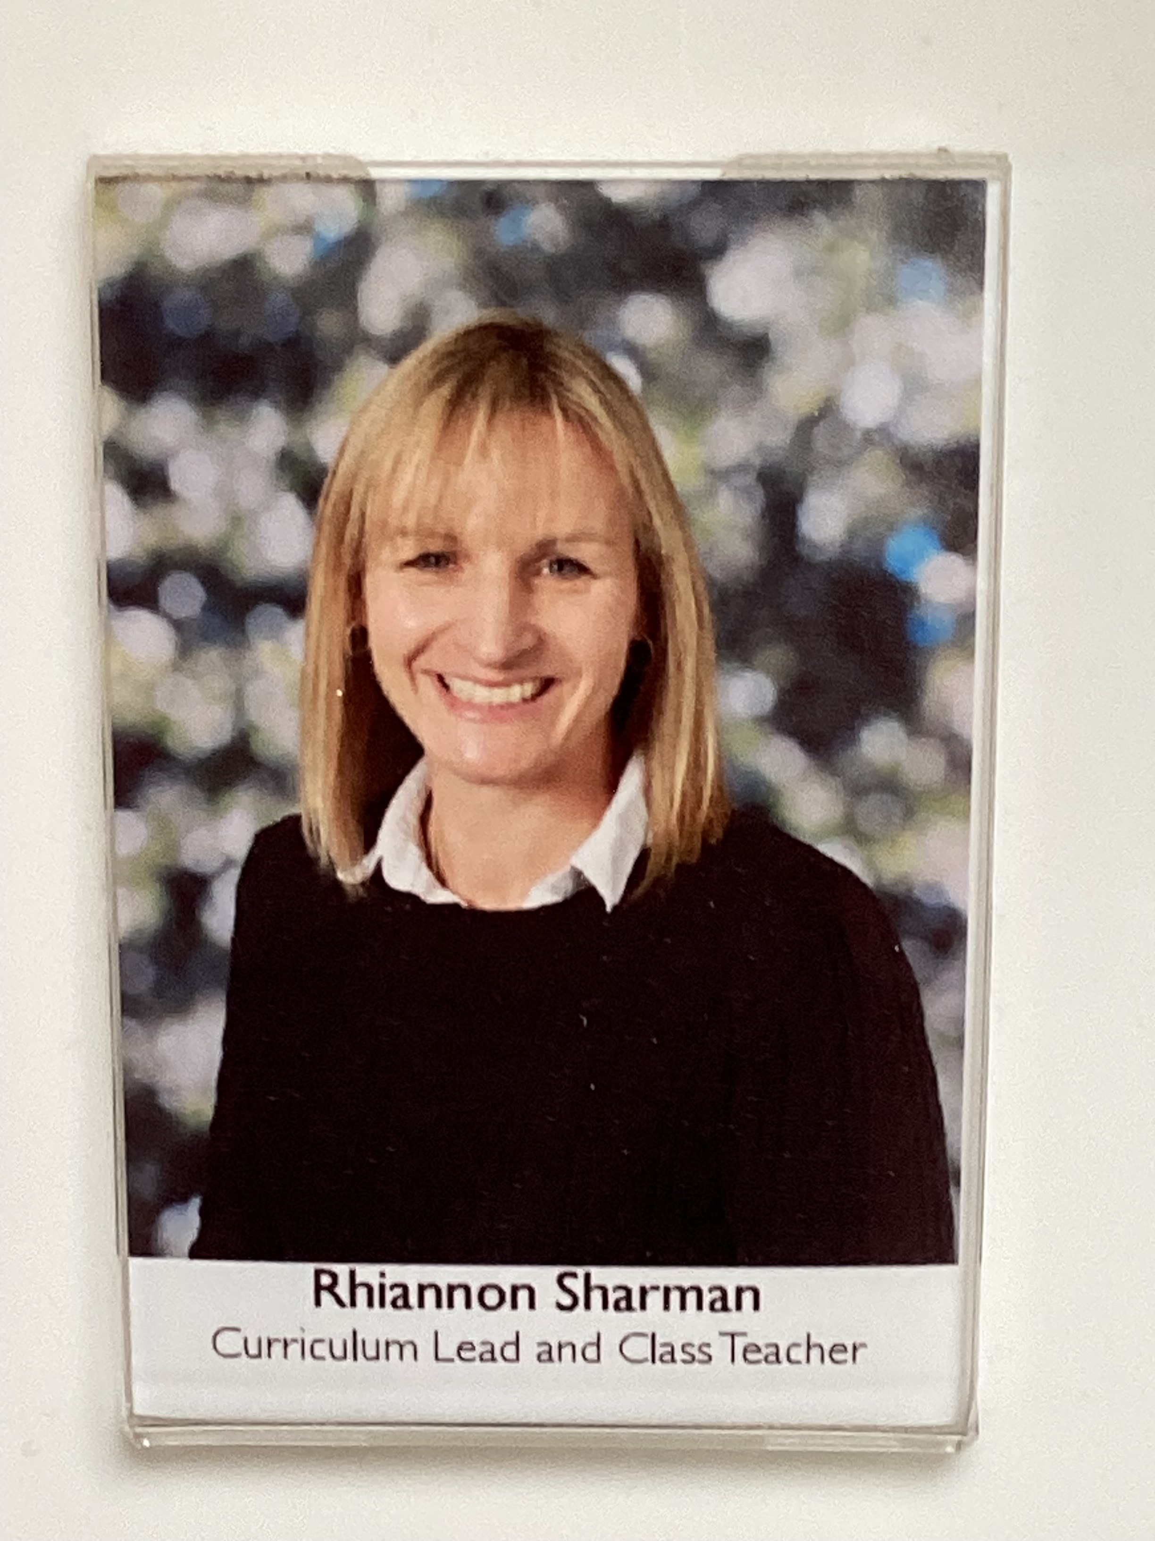
BATS Class 2024 - 2025
Year 1: Mrs ELTHAM
Miss SHARMAN (THURSDAY)
Class TA: MISS WATTS

Slide 2
Transition so far…
As part of our whole school ‘Jigsaw’ programme, we have been discussing transition / moving on during lesson time.
Teachers are holding meetings to discuss children: academic and pastoral information has been shared.
Children will have the chance to visit their new class with their teacher on Wednesday 10th July when they will complete a day of activities. In addition, children will discuss their strengths and areas for development.
Some children have started informal visits to new classrooms and areas to become familiar with the space.
Social stories will be sent out to specific children for over the summer

Slide 3
Year 1 overview
Topics for the year ahead:
Geography
Pirates
Under the Sea with a climate change/recycling focus
History
History of Toys
Dinosaurs
King and Queens
Science
Everyday Materials
Seasonal Changes
Scientists and Inventors
Plants
Animals including Humans

Slide 4
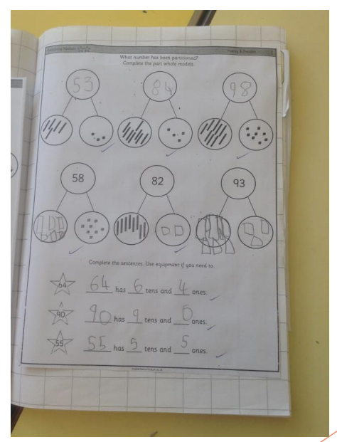
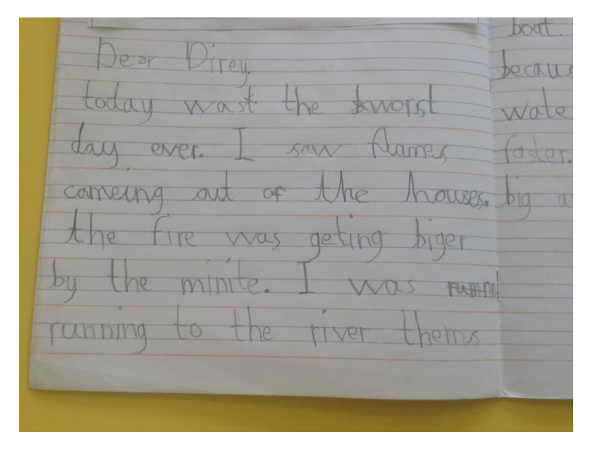
What are we aiming for?
English Maths
Maths

Slide 5
Year 1 Specifics
Communication methods – class pages, newsletters each main term, class emails, admin email, end of the day, phone…
More information about PE days etc. will be communicated in your first class newsletter. Please come in with PE kits on (like this year!) - we will try and keep days the same all year!
Any medication should be sent in at the start of each term with care plans.
Back packs can be used to carry EXTRA things for the day (water bottles, packed lunch, spare clothes if needed).
Year 1 – Phonics Screening Check in June 2025
Key Stage One – Every child MUST have a book bag for reading books and their reading diary.

Slide 6
Phonics Screening in Year 1
What is the phonics screening check?
All year 1 pupils in England take the phonics screening check. It’s done in school by our staff.
The check is made up of 40 words, and usually lasts 5-10 minutes. Some words are real words, and others are nonsense, or ‘alien’ words, that help to show if pupils can work out how to decode words they haven’t seen before.
The check helps us to see: How pupils are progressing in phonics and where to provide additional teaching and support
When will it be happening?
Year 1 will do the phonics screening check in June 2025.
We will be sharing more information about the process of this check as the academic year progresses.
Children will have daily phonics lessons in preparation for this.
The children will continue to follow the ELS phonics programme that they follow in Reception.

Slide 7
Phonics, Spelling and Reading
Reading diaries: They are a vital recording system for all year 1s and support communication between teachers and parents about progress and next steps. You need to listen to your child read at least 3 times a week and record this in their diary.
Reading books: Your child will continue to have a phonics book each week linked to their level as well as a phonics book that is linked to the phonics sounds that we are teaching that week. They will also have an opportunity to visit the KS1 library regularly and bring home a sharing book (to enjoy with an adult!)
Phonics: ELS is our phonics programme that we follow in school. This will be continued at the start of year 1 and will be delivered throughout the year.

Slide 8
Ways to support your child over the Summer holiday…
Your child’s end of year report will be sent home before the end of term. This will outline next steps that your children need to take in Maths, English and Science. Please support your child in developing these skills over the holidays, so they can hit the ground running in September.
Children should continue reading regularly over the summer holidays – this has a HUGE impact!
Ensure your child has all the uniform and equipment they need for September.

Slide 9
Involving you next year…
Class email address: bats@watlington.oxon.sch.uk if you have any small issues or messages
We will keep the class pages updated on a regular basis.
WOW events, open afternoons and assemblies will continue next year. We will try and vary the days on which these are held and give you the dates in advance.
We will hold a parents’ evening in the autumn term.

Slide 10
Any questions?
Class email: : bats@watlington.oxon.sch.uk – we will try to respond to any further questions as soon as possible.
A copy of this presentation will be included on the current Bats class page.
I am really looking forward to getting to know you and your children next year.

