Slide 1

Golden Eagles Class 2024 - 2025
Year 6: Miss Johnson
Class TA: Miss Read and Mr Murton

Slide 2
Transition so far…
As part of our whole school ‘Jigsaw’ programme, we have been discussing transition / moving on during lesson time.
Teachers are holding meetings to discuss children: academic and pastoral information has been shared.
Children will have the chance to visit their new class their teacher on Wednesday 10th July when they will complete a day of activities. In addition, children will discuss their strengths and areas for development.
Some children have started informal visits to new classrooms and areas to become familiar with the space.
Social stories will be sent out to specific children for over the summer

Slide 3

Year 6 overview
Topics:
The USA
WW2
The Ancient Maya Civilisation
Residential
SATs
Buddies
Year 6 play

Slide 4
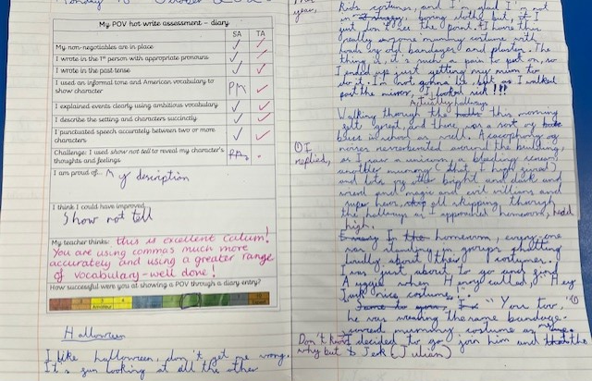
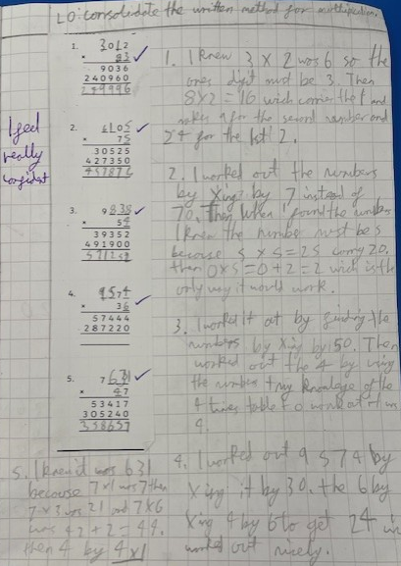
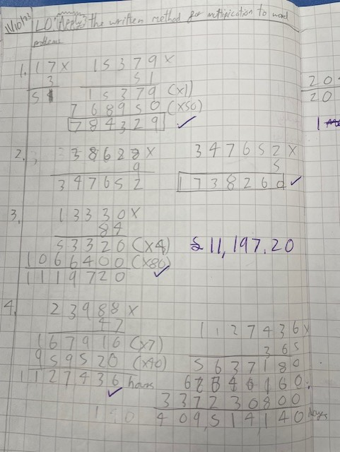
What are we aiming for?

Slide 5
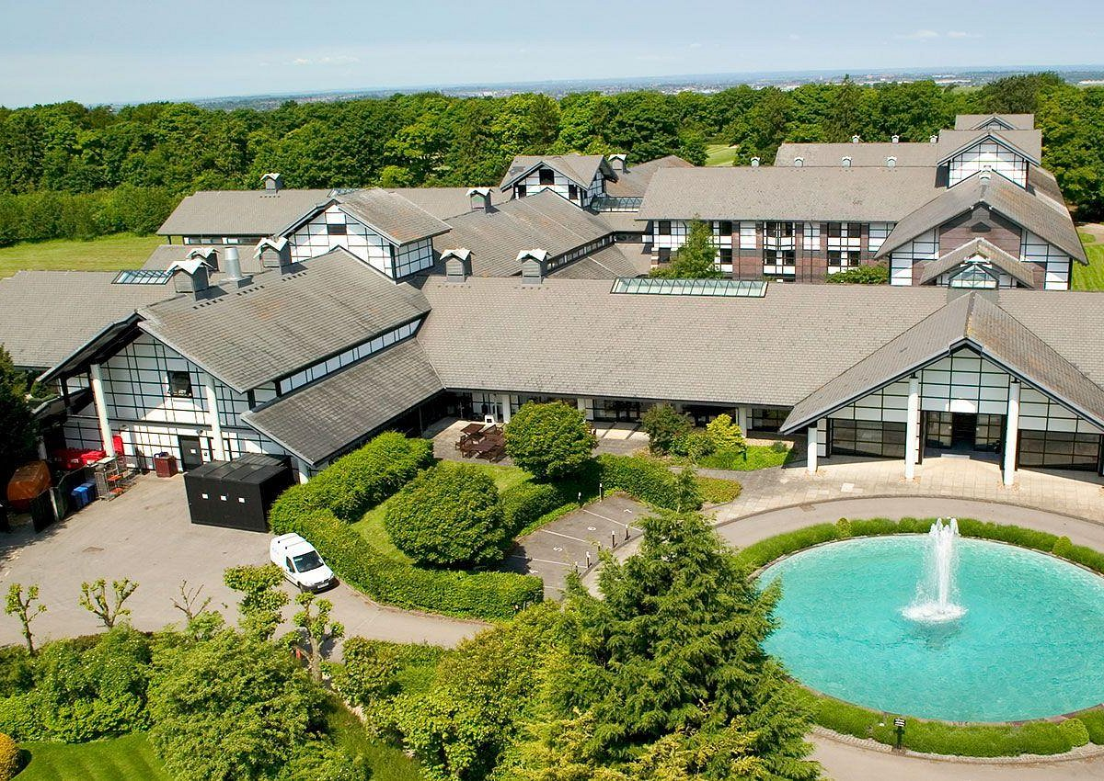
Year 6 Residential
PGL Liddington from Wednesday March 19th – Friday March 21st 2025.

Slide 6
Year 6 SATs 2025
Monday 12th - Thursday 15th May, 2025
Reading
Mathematics
Spelling, grammar and punctuation

Slide 7
Class / year group specifics
Swimming – Year 6 will go in Term 1
Communication methods – class pages, newsletters each main term, class emails, admin email, end of the day, phone etc.
More information about PE days etc, will be communicated in your first class newsletter
Any medication should be sent in at the start of term with care plans
Year 5 will start and 6 will continue learning ukuleles.
Walking home permission forms will be sent home in September. These must be returned for safeguarding reasons.
Mobile phones for Year 6 only if absolutely necessary and at your own risk – these will be collected in and stored during the school day. No watches with games on or that can be used like a phone!

Slide 8
Ways to support your child over the Summer holiday…
Your child’s end of year report will be sent home before the end of term. This will outline next steps that your children need to take in Maths, English and Science. Please support your child in developing these skills over the holidays, so they can hit the ground running in September.
Children should continue reading regularly over the summer holidays – this has a HUGE impact!
Ensure your child has all the uniform and equipment they need for September.

Slide 9
Involving you next year…
Class email address: goldeneagles@watlington.oxon.sch.uk if you have any small issues or messages
We will keep the class pages updated on a regular basis.
WOW events, open afternoons and assemblies will continue next year. We will try and vary the days on which these are held and give you the dates in advance.
We will hold a parents’ evening in the autumn term.

Slide 10
Any questions?
Class email: goldeneagles@watlington.oxon.sch.uk – we will try to respond to any further questions as soon as possible.
A copy of this presentation will be included on the current Golden Eagles class page.

